Slide 1

Python
Pandas and DataFrames

Slide 2
What is Pandas?

Slide 3
Open-source library that is built on top of NumPy library.
Offers various data structures and operations for manipulating numerical data and time series
Popular for importing and analyzing data much easier.
Pandas is fast and it has high-performance & productivity for users.
Pandas is derived from the word Panel Data – an Econometrics from Multidimensional data.

Slide 4
Need of Pandas?
In 2008, developer Wes McKinney started developing pandas when in need of high performance, flexible tool for analysis of data.
Prior to Pandas, Python was majorly used for data munging and preparation.
It had very little contribution towards data analysis.
Pandas solved this problem.
Using Pandas, we can accomplish five typical steps in the processing and analysis of data, regardless of the origin of data — load, prepare, manipulate, model, and analyze.
Python with Pandas is used in a wide range of fields including academic and commercial domains including finance, economics, Statistics, analytics, etc

Slide 5
Panda Data Structures
Pandas deals with the following three data structures −
Series
DataFrame
Panel
These data structures are built on top of Numpy array, which means they are fast.
The best way to think of these data structures is that the higher dimensional data structure is a container of its lower dimensional data structure.
For example, DataFrame is a container of Series, Panel is a container of DataFrame.

Slide 6
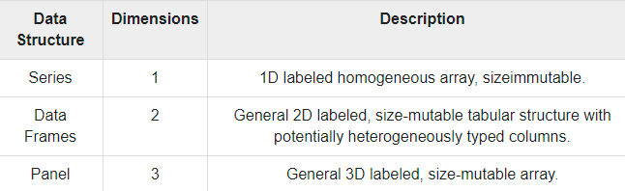

Slide 7
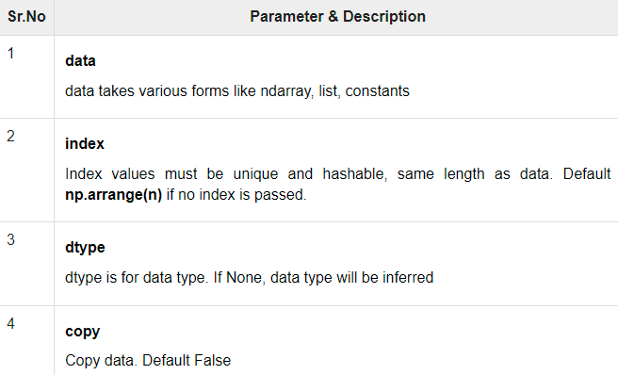
Series
Series is a one-dimensional labeled array capable of holding data of any type (integer, string, float, python objects, etc.). The axis labels are collectively called index.
Panda series is constructed using : pandas.Series( data, index, dtype, copy)

Slide 8
Creating Series
#import the pandas library and aliasing as pd
import pandas as pd
s = pd.Series()
print s

Slide 9
Create series from ndArray
#import the pandas library and aliasing as pd
import pandas as pd
import numpy as np
data = np.array(['a','b','c','d'])
s = pd.Series(data)
print(s)

Slide 10
Passing Index
#import the pandas library and aliasing as pd
import pandas as pd
import numpy as np
data = np.array(['a','b','c','d'])
s = pd.Series(data,index=[100,101,102,103])
print s
Notes:
Question: Create a Series from dict
#import the pandas library and aliasing as pd
import pandas as pd
import numpy as np
data = {'a' : 0., 'b' : 1., 'c' : 2.}
s = pd.Series(data)
print(s)

Slide 11
Indexing and Slicing Operations
import pandas as pd
s = pd.Series([1,2,3,4,5],index = ['a','b','c','d','e'])
#retrieve a single element
print(s['a'])

Slide 12
Data Frames
Two-dimensional size-mutable, potentially heterogeneous tabular data structure with labeled axes (rows and columns)
Data is aligned in a tabular fashion in rows and columns.
Pandas DataFrame consists of three principal components, the data, rows, and columns.

Slide 13
Creating Data Frame
In the real world, a Pandas DataFrame will be created by loading the datasets from existing storage, storage can be SQL Database, CSV file, and Excel file.
Pandas DataFrame can be created from the lists, dictionary, and from a list of dictionary etc

Slide 14
Data Frame from List
import pandas as pd
# list of strings
lst = ['Python', 'Pandas', 'Is', 'Not', 'That', 'Difficult!', 'At all']
# Calling DataFrame constructor on list
df = pd.DataFrame(lst)
print(df)

Slide 15
Data Frame from Dictionary
# Python code demonstrate creating # DataFrame from dict narray / lists # By default addresses.
import pandas as pd
# intialise data of lists.
data = {'Name': ['Lisa', 'Shahrukh', 'Rohan', 'Michael'],
'Age': [20, 21, 19, 18]}
# Create DataFrame
df = pd.DataFrame(data)
# Print the output.
print(df)

Slide 16
Indexing and Selection in Data Frame
# importing pandas package
import pandas as pd
# making data frame from csv file
data = pd.read_csv("myexcel.csv", index_col="Name")
# retrieving columns by indexing operator
first = data["Age"]
print(first)

Slide 17
Addition and Deletion of rows and Columns
# importing pandas module
import pandas as pd
# making data frame from csv file
data = pd.read_csv("myexcel.csv", index_col="Name")
# dropping passed values
data.drop(["Avery Bradley", "John Holland", "R.J. Hunter",
"R.J. Hunter"], inplace=True)
# display
print(data)

Slide 18
Reshaping Data Frame
Stack method works with the MultiIndex objects in DataFrame, it returning a DataFrame with an index with a new inner-most level of row labels.
It changes the wide table to a long table.
# import pandas module
import pandas as pd
# making dataframe
df = pd.read_csv("myexcel.csv")
# reshape the dataframe using stack() method
df_stacked = df.stack()
print(df_stacked.head(26))
Notes:
Without index:
import pandas as pd import openpyxl nme = ['priyank','Rohan','Sudheer','Shelen'] deg = [ 'MBA','BCA','MTEch','MBA'] scr = [90,40,50,60] dict = {'name':nme,'degree':deg,'score':scr} df = pd.DataFrame(dict) df.to_csv("data2.csv", index = False) df.to_excel("data2.xlsx", index = False)

Slide 19
Handling Missing Data in data Frame
import pandas as pd
# importing numpy as np
import numpy as np
# dictionary of lists
dict = {'First Score': [100, 90, np.nan, 95],
'Second Score': [30, 45, 56, np.nan],
'Third Score': [np.nan, 40, 80, 98]}
# creating a dataframe from list
df = pd.DataFrame(dict)
# using isnull() function
print(df.isnull())
Notes:
First Score Second Score Third Score
0 False False True
1 False False False
2 True False False
3 False True False

Slide 20
Grouping Data Frame
# importing pandas as pd
import pandas as pd
# Creating the dataframe
df = pd.read_csv(“myexcel.csv")
# First grouping based on "Team"
# Within each team we are grouping based on "Position"
gkk = df.groupby(['Team', 'Position'])
# Print the first value in each group
print(gkk.first())
import pandas as pd
# Creating the dataframe
df = pd.read_csv(“myexcel.csv")
# Print the dataframe
print(df)
#gk = df.groupby('Team')
#gk.first()

Slide 21
Sorting Data Frame
import pandas as pd
data = {'Brand': ['HH', 'TT', 'FF', 'AA'],
'Price': [22000, 25000, 27000, 35000],
'Year': [2015, 2013, 2018, 2018]
}
df = pd.DataFrame(data, columns=['Brand', 'Price', 'Year'])
# sort Brand in an ascending order
df.sort_values(by=['Year'], inplace=True)
print(df)

Slide 22
Stacking and Unstacking
# import pandas module
import pandas as pd
# making dataframe
df = pd.read_csv("myexcel.csv")
# reshape the dataframe using stack() method
df_stacked = df.stack()
print(df_stacked.head(26))
# unstack() method
df_unstacked = df_stacked.unstack()
print(df_unstacked.head(10))
Notes:
"C:\Users\Test Account\PycharmProjects\pythonProject\venv\Scripts\python.exe" "C:/Users/Test Account/PycharmProjects/pythonProject/Bubble sort.py"
0 Name Avery Bradley
Team Boston Celtics
Number 0.0
Position PG
Age 25.0
Height 6-2
Weight 180.0
College Texas
Salary 7730337.0
1 Name Jae Crowder
Team Boston Celtics
Number 99.0
Position SF
Age 25.0
Height 6-6
Weight 235.0
College Marquette
Salary 6796117.0
2 Name John Holland
Team Boston Celtics
Number 30.0
Position SG
Age 27.0
Height 6-5
Weight 205.0
College Boston University
dtype: object
Name Team Number ... Weight College Salary
0 Avery Bradley Boston Celtics 0.0 ... 180.0 Texas 7730337.0
1 Jae Crowder Boston Celtics 99.0 ... 235.0 Marquette 6796117.0
2 John Holland Boston Celtics 30.0 ... 205.0 Boston University NaN
3 R.J. Hunter Boston Celtics 28.0 ... 185.0 Georgia State 1148640.0
4 Jonas Jerebko Boston Celtics 8.0 ... 231.0 NaN 5000000.0
5 Amir Johnson Boston Celtics 90.0 ... 240.0 NaN 12000000.0
6 Jordan Mickey Boston Celtics 55.0 ... 235.0 LSU 1170960.0
7 Kelly Olynyk Boston Celtics 41.0 ... 238.0 Gonzaga 2165160.0
8 Terry Rozier Boston Celtics 12.0 ... 190.0 Louisville 1824360.0
9 Marcus Smart Boston Celtics 36.0 ... 220.0 Oklahoma State 3431040.0
[10 rows x 9 columns]
Process finished with exit code 0

Slide 23
Concatenating and Merging Data Frame
# importing pandas module
import pandas as pd
# Define a dictionary containing employee data
data1 = {'Name': ['Jai', 'Princi', 'Gaurav', 'Anuj'],
'Age': [27, 24, 22, 32],
'Address': ['Nagpur', 'Kanpur', 'Allahabad', 'Kannuaj'],
'Qualification': ['Msc', 'MA', 'MCA', 'Phd'],
'Mobile No': [97, 91, 58, 76]}
# Define a dictionary containing employee data
data2 = {'Name': ['Gaurav', 'Anuj', 'Dhiraj', 'Hitesh'],
'Age': [22, 32, 12, 52],
'Address': ['Allahabad', 'Kannuaj', 'Allahabad', 'Kannuaj'],
'Qualification': ['MCA', 'Phd', 'Bcom', 'B.hons'],
'Salary': [1000, 2000, 3000, 4000]}

Slide 24
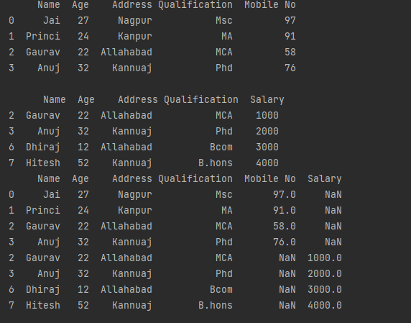
# Convert the dictionary into DataFrame
df = pd.DataFrame(data1, index=[0, 1, 2, 3])
# Convert the dictionary into DataFrame
df1 = pd.DataFrame(data2, index=[2, 3, 6, 7])
print(df, "\n\n", df1)
# using a .concat() method
frames = [df, df1]
res1 = pd.concat(frames)
print(res1)

Slide 25
Pandas Time Series
We can include the date and time for every record and can fetch the records of dataframe.
We can find out the data within a certain range of date and time by using pandas module named Time series.

Slide 26
import pandas as pd
from datetime import datetime
import numpy as np
range_date = pd.date_range(start='1/1/2019', end='1/08/2019',
freq='Min')
print(range_date)
Notes:
Here in this code, we have created the timestamp on the bases of minutes for date ranges from 1/1/2019 – 8/1/2019. This function will help you to track the record of data stored per minute. As we can see in the output the length of the datetime stamp is 10081. Remember pandas use data type as datetime64[ns].

Slide 27
EDA using Pandas
EDA is a phenomenon under data analysis used for gaining a better understanding of data aspects like: – main features of data – variables and relationships that hold between them – identifying which variables that are important for our problem
https://vincentarelbundock.github.io/Rdatasets/datasets.html
Data can be grouped
Data can be corelated
Data can be counted

Slide 28
Exporting Dataframe to CSV and Excel
# importing pandas as pd
import pandas as pd
# list of name, degree, score
nme = ["Priyanka", "Rohan", "Sudheer", "Shelen"]
deg = ["MBA", "BCA", "M.Tech", "MBA"]
scr = [90, 40, 80, 98]
# dictionary of lists
dict = {'name': nme, 'degree': deg, 'score': scr}
df = pd.DataFrame(dict)
# saving the dataframe
df.to_csv('file1.csv')

Slide 29
Head and tail method
# import pandas module
import pandas as pd
# making dataframe
df = pd.read_csv("myexcel.csv")
# reshape the dataframe using stack() method
df_stacked = df.stack()
print(df_stacked.head(26))
# unstack() method
df_unstacked = df_stacked.unstack()
print(df_unstacked.head(10))

Slide 30

THANK YOU
www.skillslash.com

